Slide 1
NeuLog Quick Guide
Basic demonstration of NeuLog sensors using:
software, Wi-Fi module and display modules

Slide 2
NeuLog Logger sensors
NeuLog sensors are logger sensors.
The tiny computer in each sensor samples, processes and stores the data.
The probe connected to the sensor is pre-calibrated in the factory and no further calibration is required.
The data stored by the sensor is processed digital data.
The sensor has different measurement ranges and changing the measuring range or type of processing is simply done on the computer screen.

Slide 3
NeuLog Logger sensors
The sensors may be plugged to one another for more complex experiments with almost no limitation on the composition and number of sensors in the chain.
NeuLog has over 60 different sensors.
Some sensors perform as two or even three sensors, and changing the sensor’s function is done by a simple click.

Slide 4
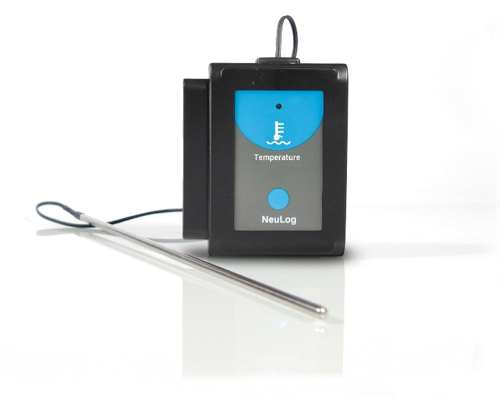
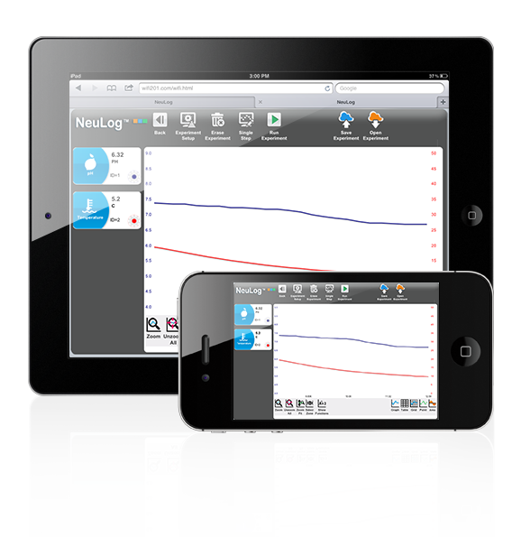
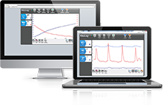
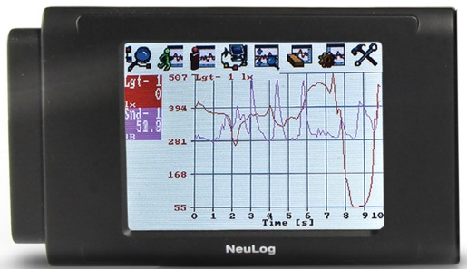
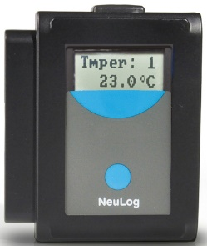
Device options
PC or Mac
Tablet or Smartphone
Graphic or Digital viewer

Slide 5
You will use the following logger sensors for the demonstration:

Slide 6
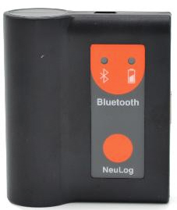
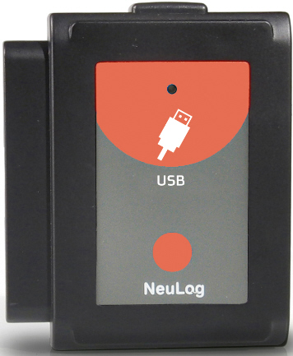
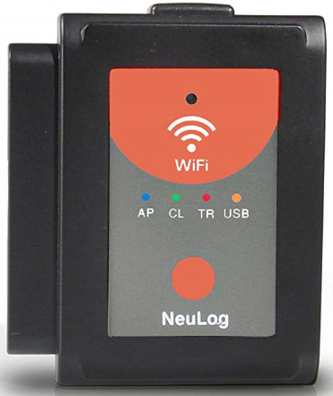
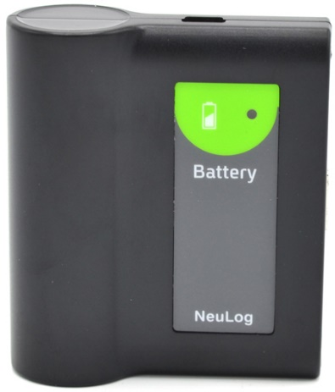
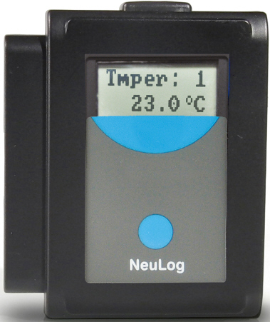
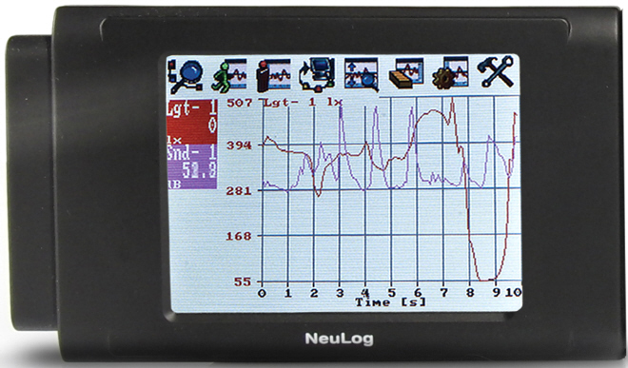
You will also use the following modules for the demonstration:
BLT-202
USB-200
WIFI-202
BAT-202
VIEW-200
VIEW-101

Slide 7
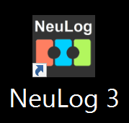
Logger sensor with PC
Connect the Sound and Light sensors to the USB-200.
Connect the USB-200 to the PC USB socket.
Run the NeuLog software.
Any chain of sensors
Computer
+

Slide 8
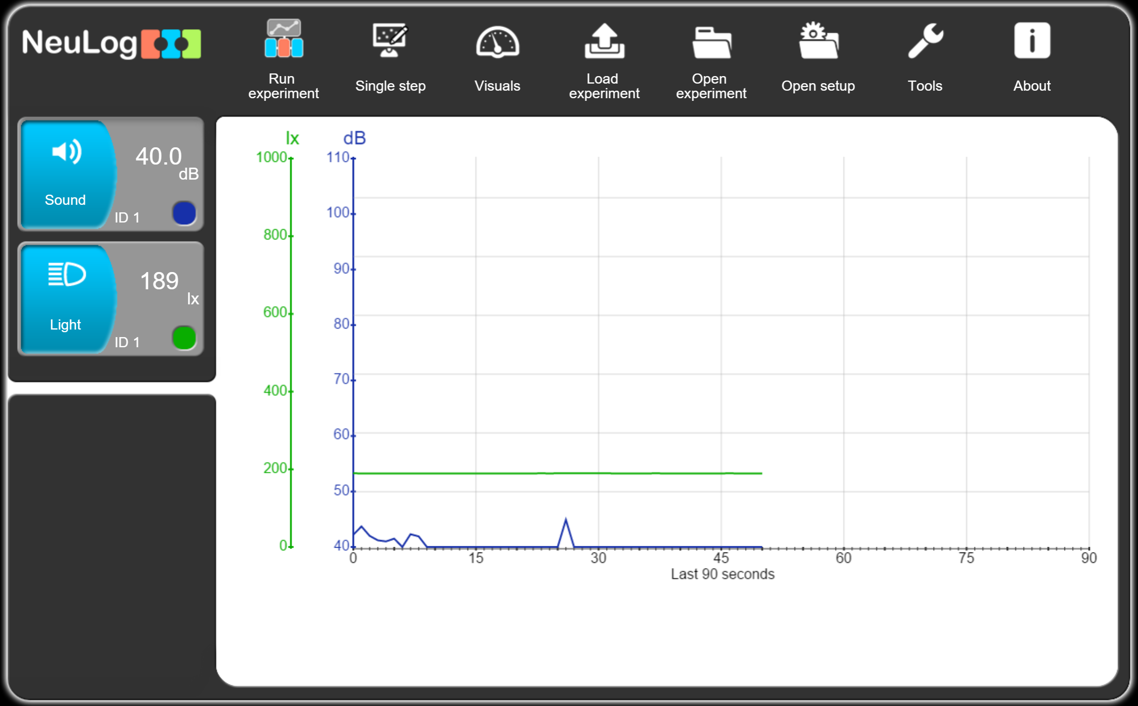
NeuLog Software
Opening screen
The NeuLog software is browser based.
This is why NeuLog has a single software for all computer platforms, including tablets and smartphones.
At this screen the software displays the sensors' samples every one second on the accumulated graphs and on the sensors' pictures.

Slide 9
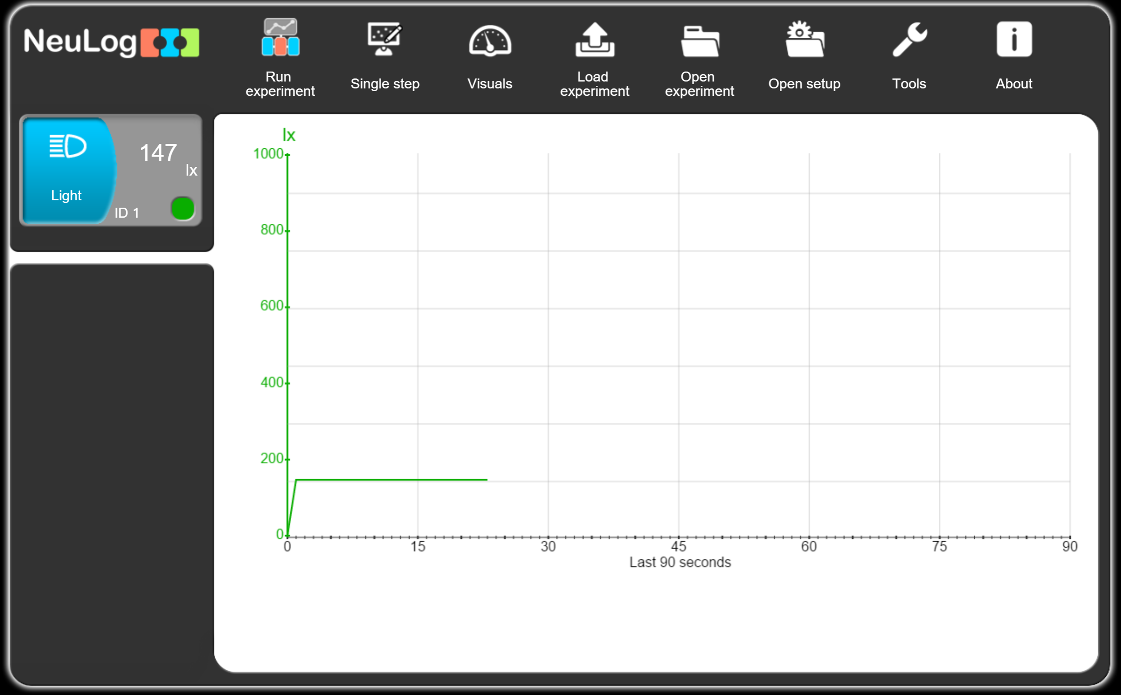
NeuLog Software
Changing sensors
Disconnect the sound sensor.
This will automatically be identified by the software.
Direct the sensor to the lamp and to the ground.

Slide 10
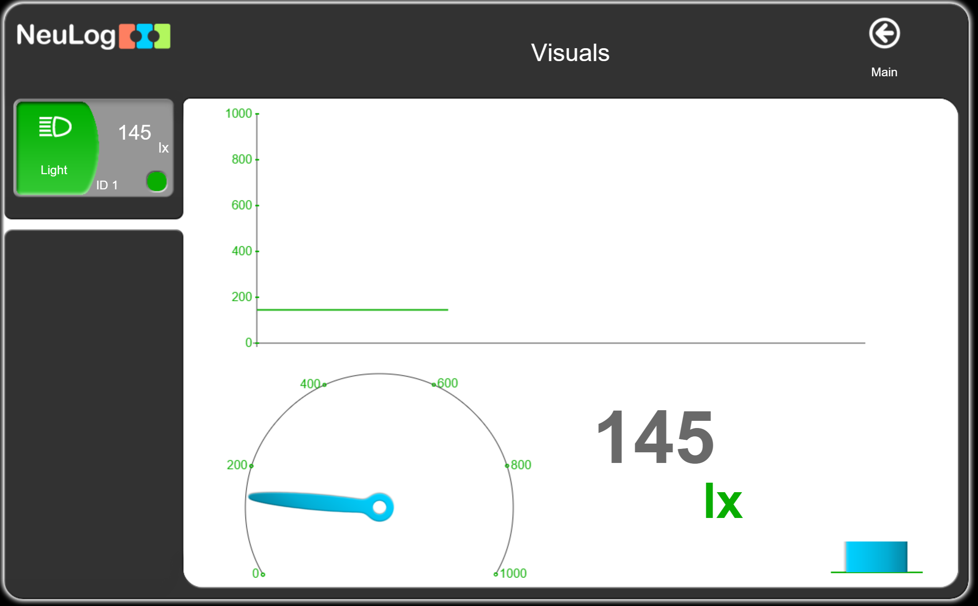
NeuLog Software
Visual Screen
Click on the 'Visuals' button and you will get the following screen.
This screen is excellent for displaying reactions without running experiments.
Click on the 'Main' button on the right to return to the main screen.

Slide 11
NeuLog Software
Running an experiment
The concept of NeuLog software is to show on the screen only what you may need (What You See is What You Need).
The software guides the user how to use it intuitively.
Click on the 'Run experiment' button.

Slide 12
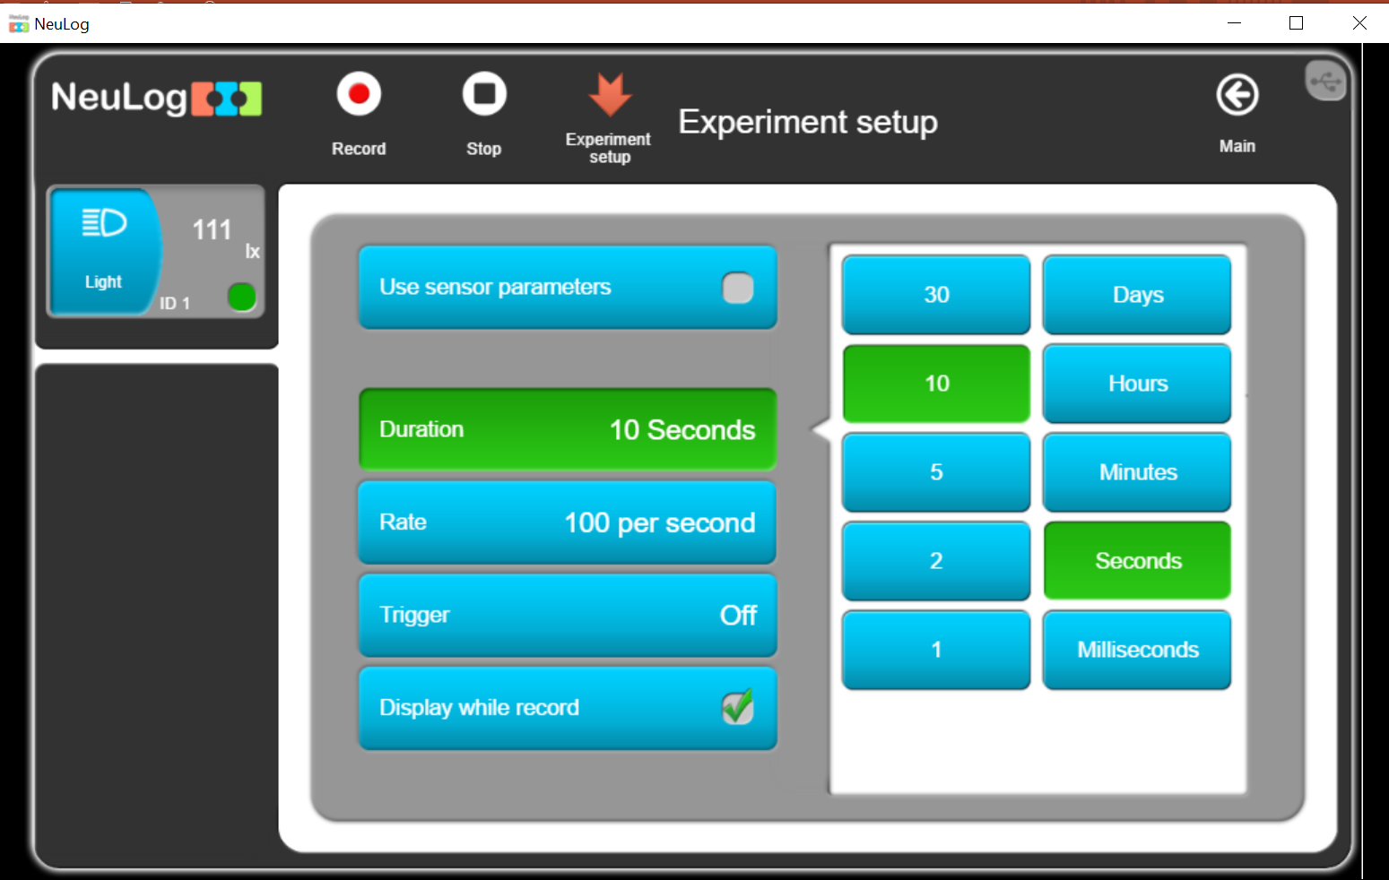
NeuLog Software
Experiment parameters
This screen shows the experiment’s parameters (duration and sampling rate) with the default setup.
The parameters can be changed.
You can use the parameters saved in the sensor flash memory (explained later).
You can also use the trigger options.
You can click on the 'Experiment setup' button to send the experiment setup to the sensors to shorten the time between clicking on the 'Record' button and running the experiment.
Click on the 'Record' button.

Slide 13
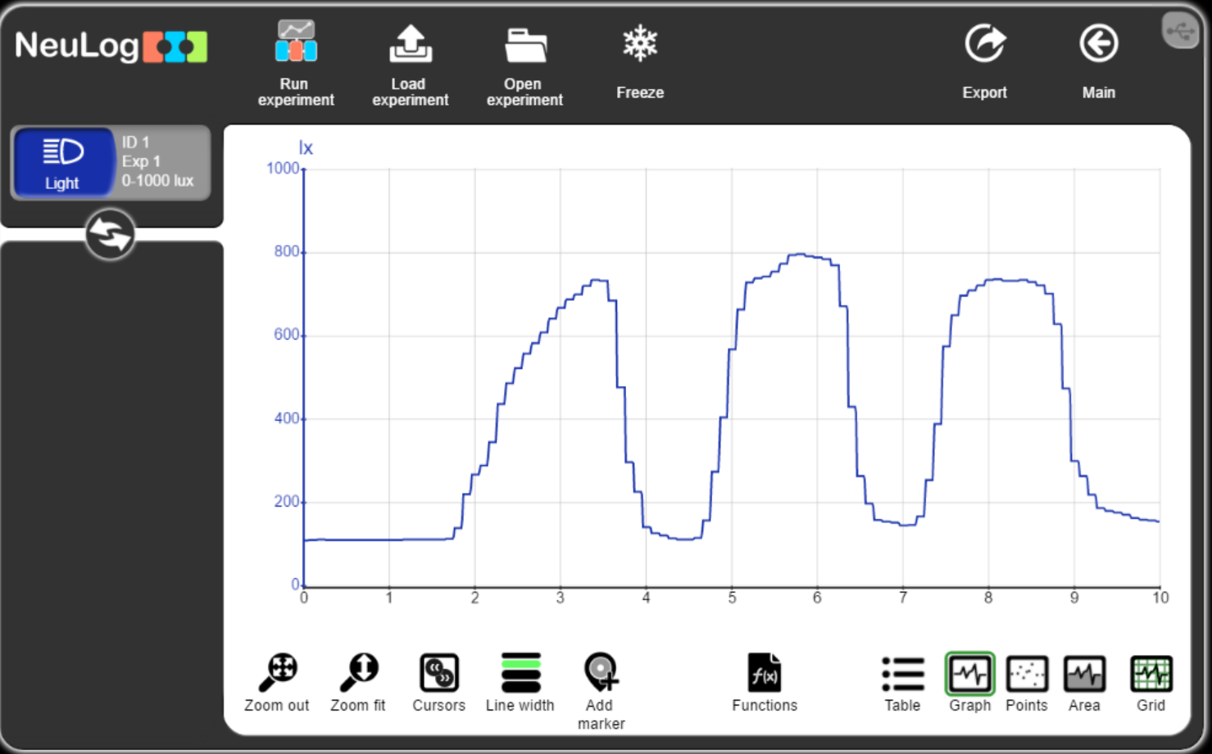
NeuLog Software
Experiment results
While the experiment is running, direct the light sensor to the lamp and then to the floor until the experiments stops.
You will get a screen similar to the screen below.
The sensor image on the left shows the participating sensors, but without reading the sensors.
To see the live sensors click on the double arrows button.

Slide 14
NeuLog Software
Experiment analysis
Use the buttons below to analyze the experiment's results.
Export the experiment; save it as a CSV file or as an image, mail it, print the graph or save the experiment setup.
You can freeze the graph and run another experiment, or open a saved experiment so you will see the two graphs on the same screen.
The 'Functions' button enables many mathematical manipulation on the results.

Slide 15
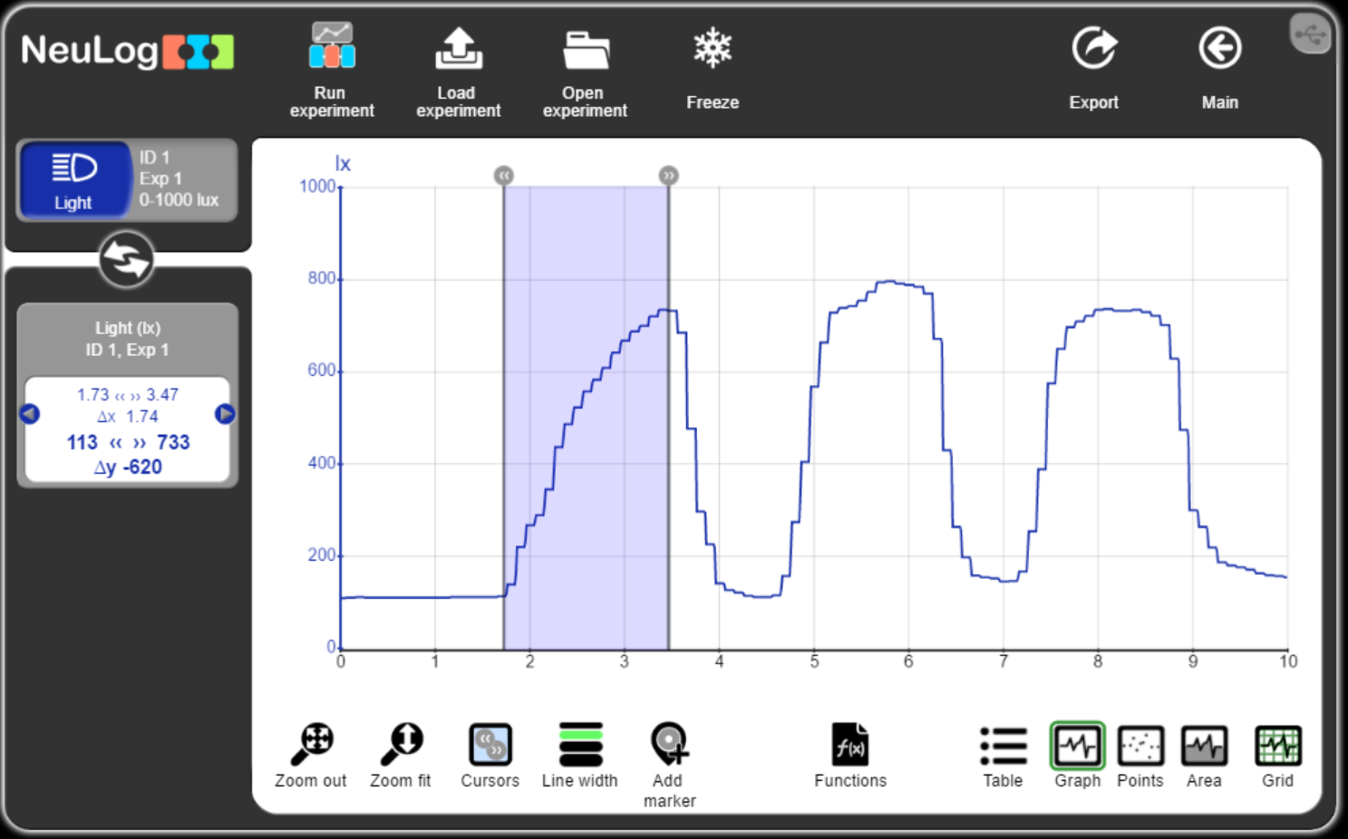
NeuLog Software
Experiment results
Display the cursors and drag them.
The square on the left shows the cursors' values of X and Y.

Slide 16
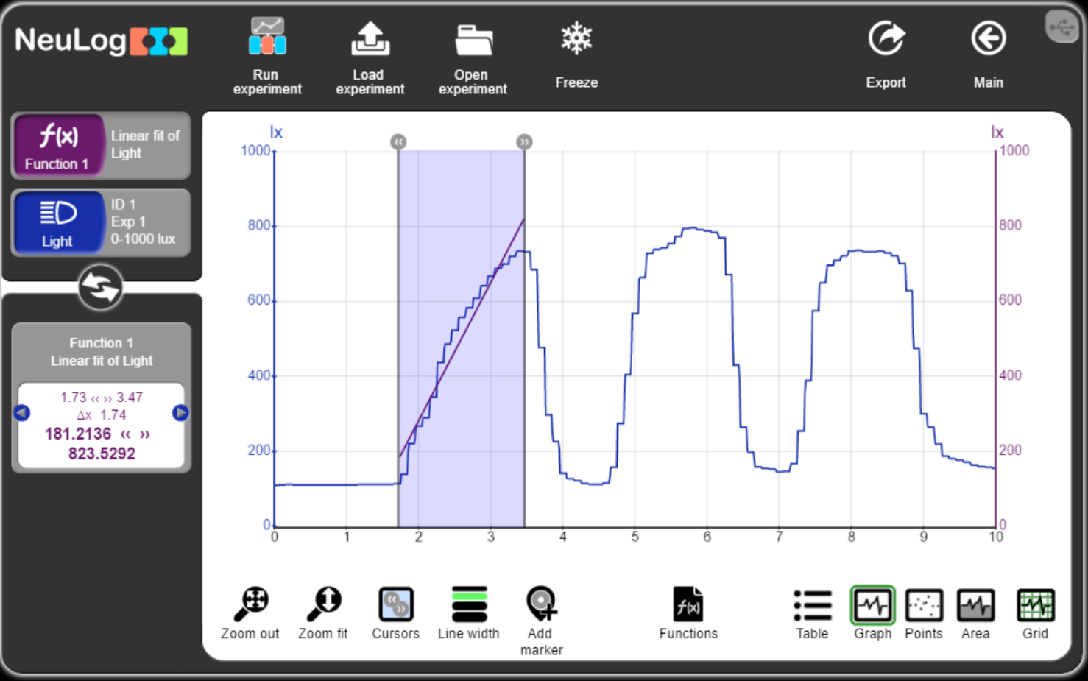
NeuLog Software
Experiment results
Calling a function (like the linear fit displayed below), creates another graph accordingly.
Calling the function without cursors will operate the function on the entire results.
Clicking on the new graph button, will displays the graph formula and parameters such as: highest, lowest, average, area and standard deviation values.

Slide 17
NeuLog Software
Experiment analysis
The 'Functions' button enables many mathematic manipulations for the results of a certain sensor graph A or two sensors A and B, with or without a constant K.
A+k, A-K, A*K, A/K, A+B, A-B, A*B, A/B,
dA/dB, dA/dB², ∫Adt, dA/dt, LogA, LnA, e^A, 10^A,
A², A^{1/2}, 1/A, 1/A², FFT(A), Zoom fit, Polynomial (A)
The graph created by the function is given a button, and a new manipulation can be done on it, with or without a sensor.

Slide 18
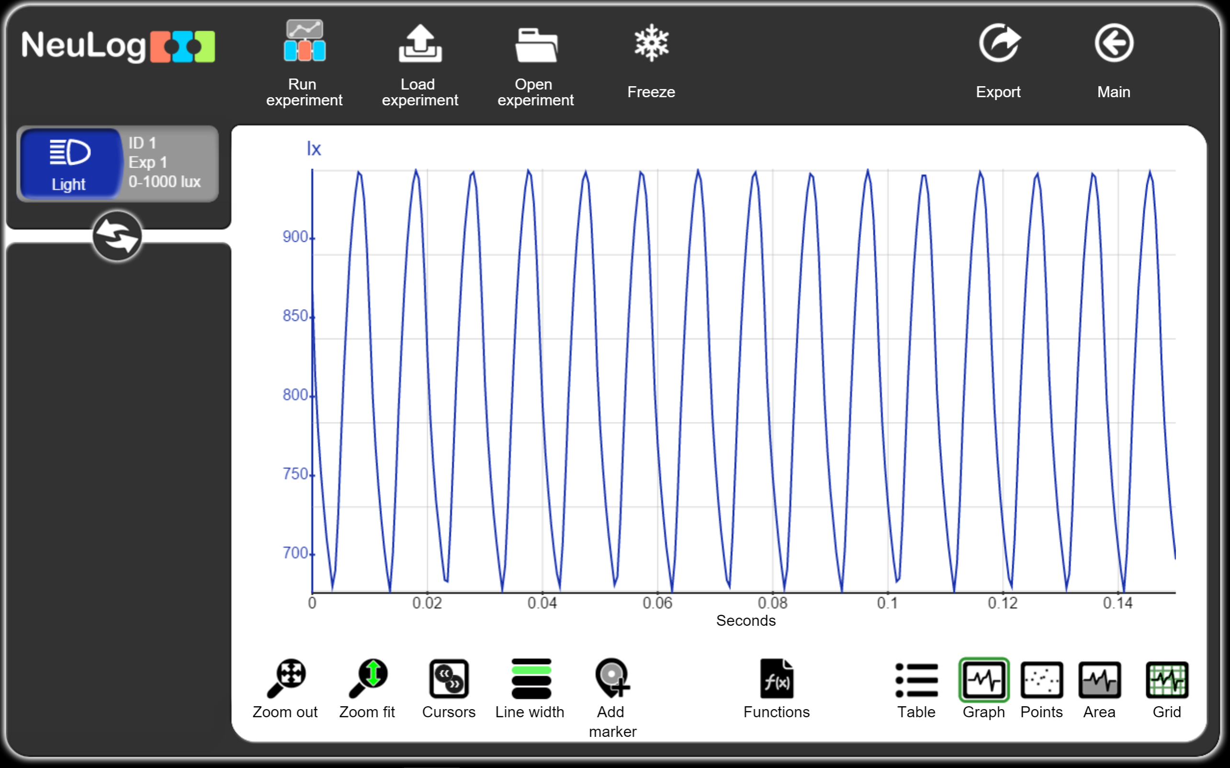
NeuLog Software
FFT Experiment
Return to the Main screen.
Set the experiment parameters to 150ms duration and 2000 sampling rate.
Direct the light sensor to the room's lamp and click on the 'Record' button.
Click on the 'Zoom Fit' button.

Slide 19
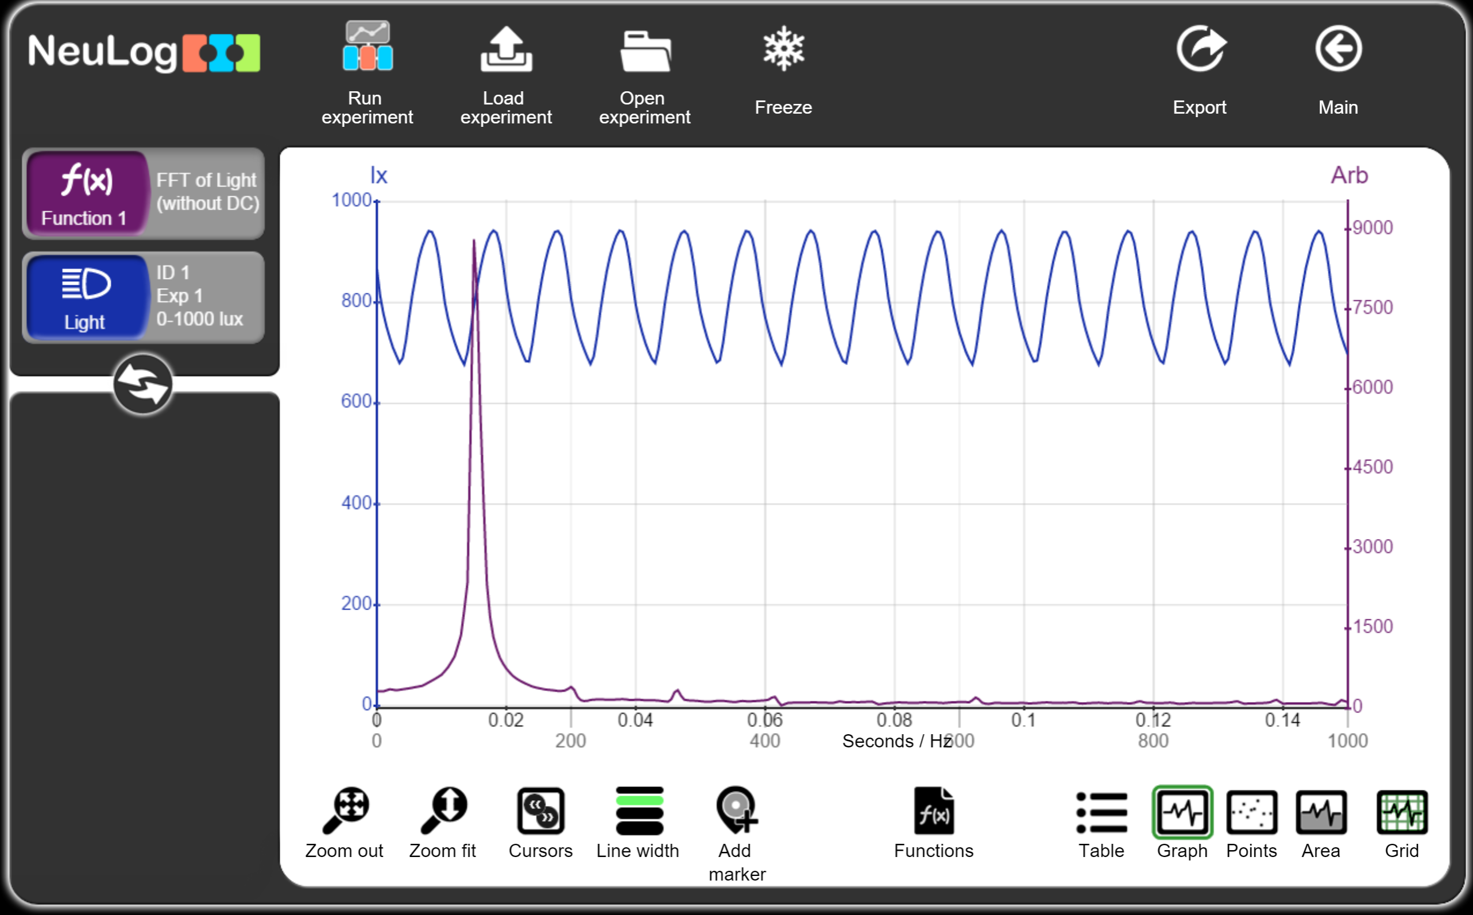
NeuLog Software
FFT Experiment
Click on the 'Function' button.
Select the 'FFT de A (sin CD)' and you will get the following screen with a peak at 100Hz.

Slide 20
NeuLog Software
Off-Line Mode
Return to the Main screen.
Click on the sensor image.

Slide 21
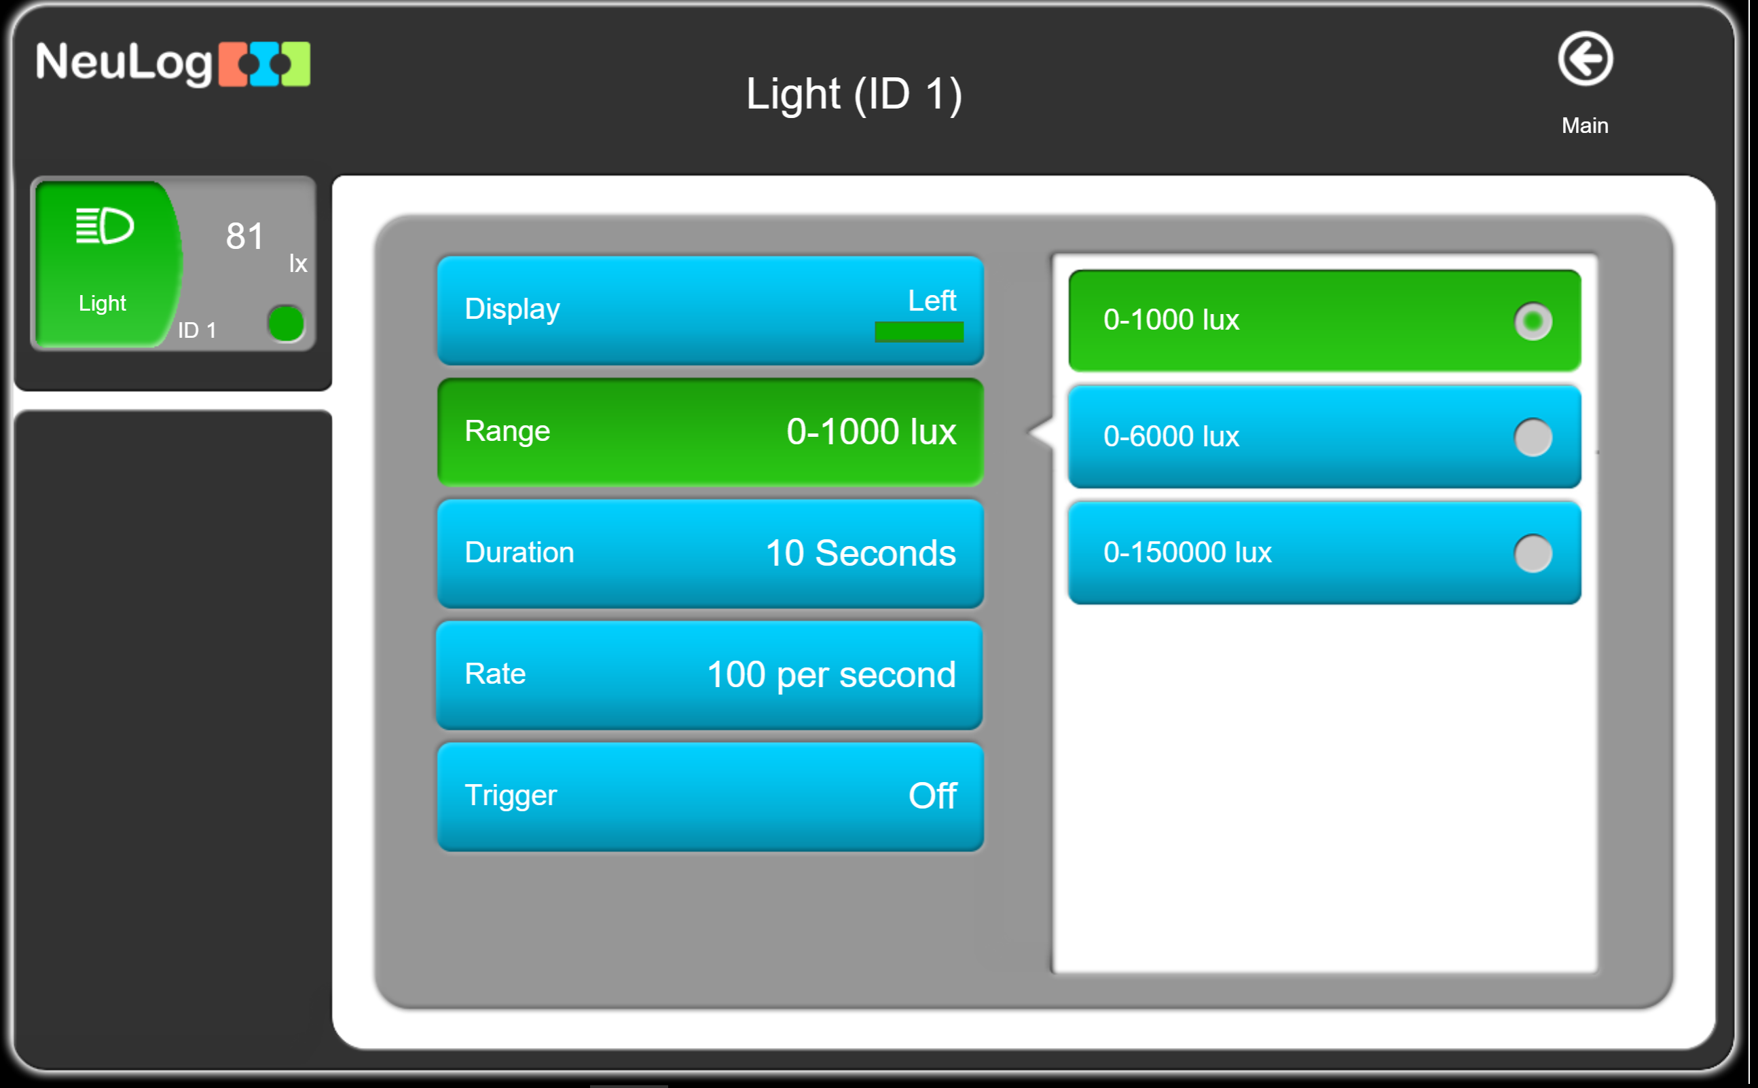
NeuLog Software
The sensor parameters
This screen shows the sensor’s parameters in its flash memory.
You can change the range of the sensor, the Duration, the sampling Rate and the Trigger for an Off-line experiment.
Check that the Duration is 10 seconds and the Rate is 100 per second.

Slide 22
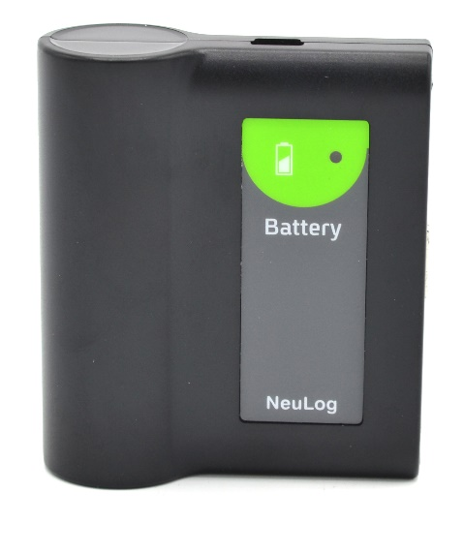
NeuLog Software
Off-line Experiment Run
Disconnect the sensor from the PC.
Connect it to the battery module.
Press the Start/Stop button.
The LED on the sensor will blink for 10 seconds indicating experiment run.
Direct the sensor to a lamp and to the ground.
When the blinking stops, repeat the experiment again.
Start/Stop

Slide 23
NeuLog Software
Load Off-line Experiment results from the senor
Disconnect the sensor from the battery module and connect it again to the PC using the USB module.
Check that you have the main screen as shown below.

Slide 24
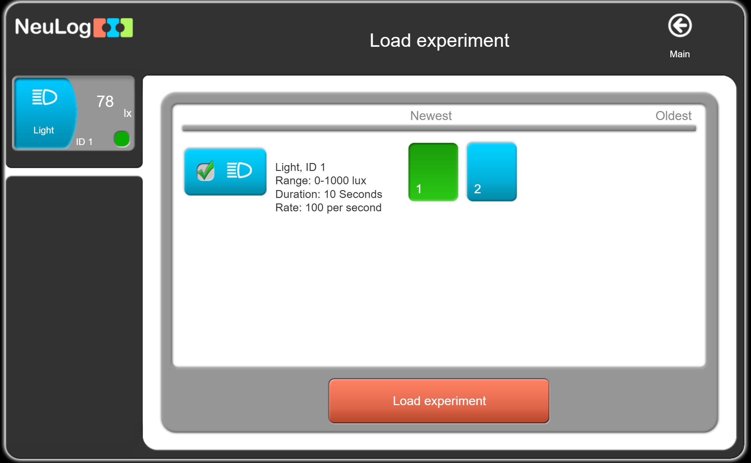
NeuLog Software
Load Off-line Experiment results from the senor
The opened window shows the saved experiments in the sensor flash memory.
They can be up to 5 saved experiments.
The first on the left is the last one and it is selected.
You can select any of the saved experiments.
Click on the 'Load experiment' button.

Slide 25
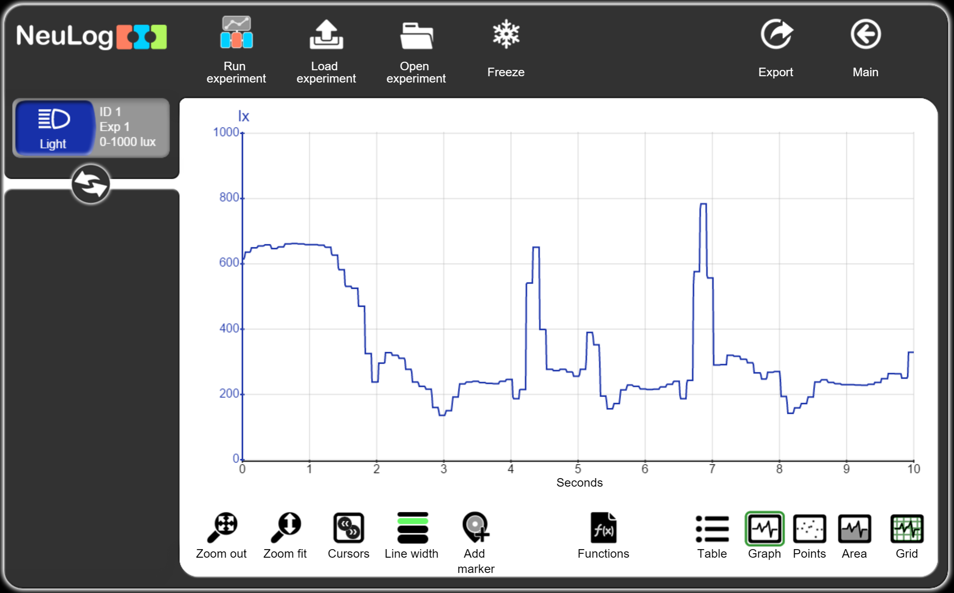
NeuLog Software
Load Off-line Experiment results from the senor
The saved experiment’s results are loaded and displayed on the screen.
You can export the experiment, freeze and load another one, etc.

Slide 26
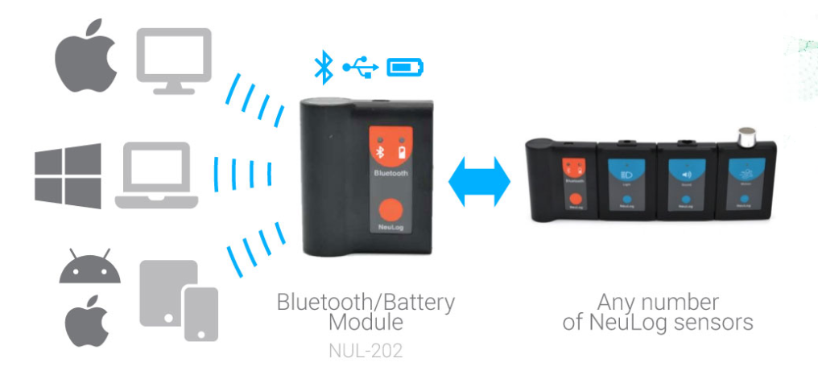
The Bluetooth/USB module is a single interface for all computing platforms
Bluetooth / USB /
battery 2300mAh
Wire or wireless connection
Any sensor configuration
PC, MAC,
iPAD or Tablet,
Smartphone
Notes:
בעזרת מודול בלוטות הכוללUSB וסוללה של 2300 מיליאמפר שעה ניתן לחבר כל הרכב אפשרי של חיישנים לכל פלטפורמת מחשוב כגון: מחשב PC, מחשב מק, איפד, טאבלט או סמרטפון

Slide 27
Bluetooth module
Working with tablets and smartphones
The Bluetooth module enables connecting many logger sensors to tablets and smart phones.
It includes a large capacity rechargeable battery (2300 mAh).
It can also be used for wire connection to PC and MAC.
Connect the light sensor to the Bluetooth (BLT) module.
Check that the Bluetooth is enabled on your tablet.
Press the orange button on the BLT module.
The blue LED will start blinking.
Run the NeuLog application software on your tablet.
When only one BLT module is available, the connection to the BLT module will be done automatically; otherwise you have to select the module from the open list.
The blinking will stop and the opening screen will appear.
Any chain of sensors
+

Slide 28
Wi-Fi module
Working with tablets and smartphones
The WIFI-202 module enables connecting sensors to any computer platform via Wi-Fi.
The NeuLog software is already installed in the WIFI-202 module.
You do not have to use any application software, just surf to the module.
Every WIFI-202 module has a different network and its network name is marked on its back. It this way, more than one module can work in the same classroom.
Any chain of sensors
Power source, computer, plug, battery module
+

Slide 29
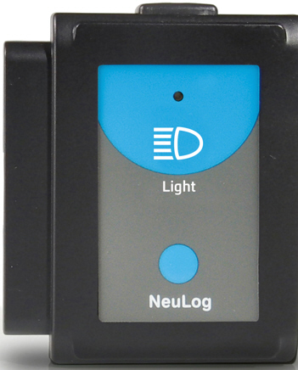
Wi-Fi module
Working with tablets and smartphones
Connect the modules as demonstrated in the picture.
The WiFi-201 indicator lights will flash for about 40 seconds.
Wait until the LED turns blue.
Open the Wi-Fi settings in your system and select the NeuLog network, which matches the Wi-Fi module ID found on the back of the WIFI-202 module (NeuLog1334 for example).
Open the WEB browser and surf to the wifi201.com website.
You will get the same NeuLog software Main screen and you can work the same as previously.
Power source, computer, plug, battery module

Slide 30
Wi-Fi module
Viewer Mode
The first one who surf to the WIFI-202 network and to wifi201.com, becomes the Master. He can run the experiments.
All the other users who afterwards surf to the same network and site, become Viewers.
They can see everything that the Master is doing but cannot participate. In this way a teacher can demonstrate an experiment to all the class students.
After the Master saves the experiment, the viewers can load the file to their tablets.
Power source, computer, plug, battery module

Slide 31
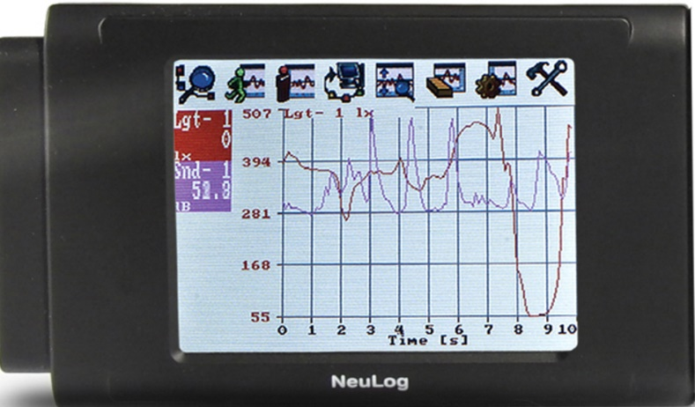
VIEW-101
Graphic display module
The VIEW-101 module is used for running experiments without a PC.
It displays the sensor's measurements in digital and graphical forms.
Automatic recognition of sensors:
Connect the viewer to the sensors.
Also connect the battery module.
After both sensors are found click on the button.
Point the sensor towards the light source or make some sounds.
X
+
Any chain of sensors

Slide 32
VIEW-101
Graphic display module
The VIEW-101 module uses preset experiment parameters for easy initiation.
Click on the Run experiment icon to start the measurement.
Click on the Zoom fit icon to see the graph at full screen.
Erase the graph by clicking on the Erase icon .
Change the parameters by clicking on the experiment setup icon (experiment duration and sampling rate).
Click on the sensor's module box to change the sensor's range.
Run an experiment again.
Five sensors can be viewed at the same time.

Slide 33
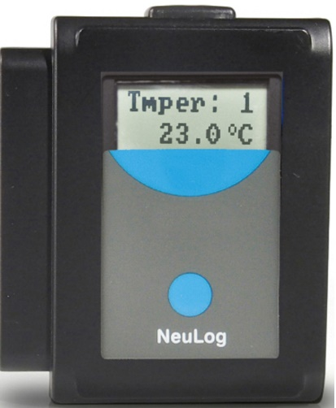
VIEW-200
Digital display module
The Digital display module VIEW-200 enables viewing the current measured values of the connected sensors in Off-line mode.
The module enables viewing one sensor at a time, but to browse from one module to another.
Connect the sensors to the viewer.
Connect the battery module.
The VIEW-200 automatically searches for the connected sensors and digitally displays one of them.
Wait until the viewer finds the sensor.
To change the displayed sensor’s value (light instead of sound for instance), click on the viewer’s blue pushbutton.
Any chain of sensors
+
Pushbutton

Slide 34
Thank you
Bluetooth / USB /
battery 2300mAh
Wire or wireless connection
Any sensor configuration
PC, MAC,
iPAD or Tablet,
Smartphone
Notes:
בעזרת מודול בלוטות הכוללUSB וסוללה של 2300 מיליאמפר שעה ניתן לחבר כל הרכב אפשרי של חיישנים לכל פלטפורמת מחשוב כגון: מחשב PC, מחשב מק, איפד, טאבלט או סמרטפון

